Slide 1




E commerce Data Analysis using Excel
STUDENT NAME: UDHAYAPRAKASH.U
REGISTER NO: 422200025
DEPARTMENT: B.COM(INFORMATION SYSTEM MANAGEMENT)
COLLEGE: S.I.V.E.T COLLEGE

Slide 2
PROJECT TITLE
E commerce Data Analysis using Excel

Slide 3


AGENDA
Problem Statement
Project Overview
End Users
Our Solution and Proposition
Dataset Description
Modelling Approach
Results and Discussion
Conclusion
3/21/2024 Annual Review

Slide 4

PROBLEM STATEMENT
Customer- facing issue
Operational Challenges
Technical difficulties
Marketing sales
Supply chain and Logistics
Security and compliance

Slide 5

PROJECT OVERVIEW
Define the primary goals of the e-commerce project, such as increasing online sales, reaching new markets, or improving customer experience.
.
Scope
Target Audience
Technology Stack
Design and User Experience
Timeline and Milestones
Team and Roles

Slide 6

WHO ARE THE END USERS?
Consumers (B2C): Individual shoppers who purchase goods or services for personal use.
Businesses (B2B): Companies that buy products or services from other businesses for their own operations or resale.
Sellers or Vendors: Businesses or individuals who list their products or services on the e-commerce platform.
Administrators: Internal users who manage the platform’s operations, including content management, customer service, and transaction processing.
Third-Party Partners: This includes payment processors, shipping companies, and other service providers integrated into the e-commerce platform.

Slide 7

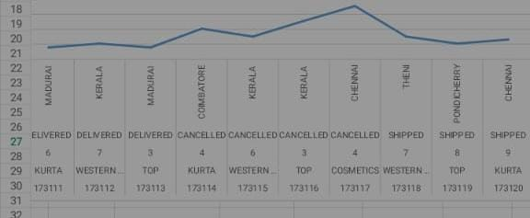
OUR SOLUTION AND ITS VALUE PROPOSITION

Slide 8
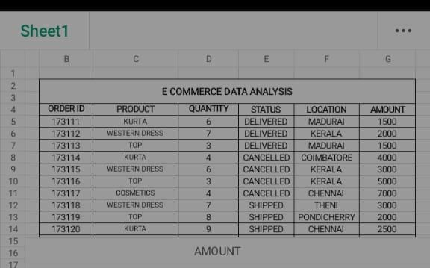
Dataset Description

Slide 9
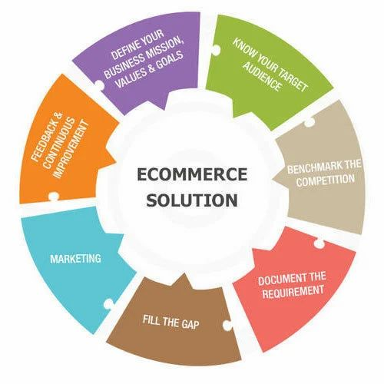

THE "WOW" IN OUR SOLUTION
3/21/2024 Annual Review
9

Slide 10
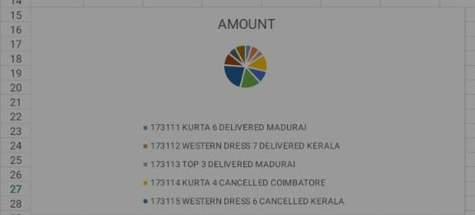
MODELLING
10

Slide 11
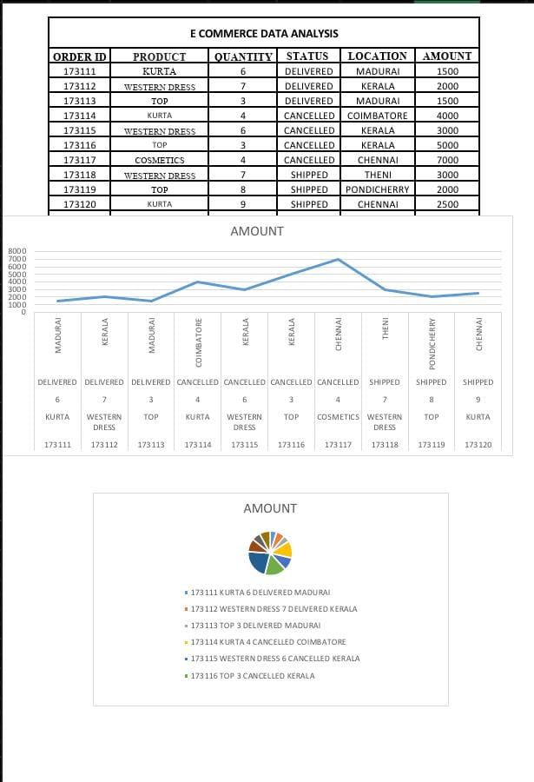
RESULTS
11

Slide 12
conclusion
Conclusion, the e-commerce project has successfully met its core objectives by enhancing the online shopping experience and achieving measurable improvements in key performance metrics. By focusing on user experience, technological integration, and efficient operations, the project has led to increased customer engagement and higher conversion rates.

